Slide 1
Unit III Advanced graphing and charting
By: Amanpal Singh

Slide 2
Table of contents
Charting : charts, combo charts, working with objects charts
Dynamic charts and dynamic data source for charts print areas
Views for a worksheet
various printing techniques.
Data protection techniques : worksheet protection, protect specific range, workbook protection and encryption.

Slide 3
1. Charts
A chart is a graphical representation for data visualization, in which "the data is represented by symbols, such as bars in a bar chart, lines in a line chart, or slices in a pie chart". A chart can represent tabular numeric data, functions or some kinds of quality structure and provides different info. [ref: Wikipedia]

Slide 4
Static VS Dynamic charts
For the purposes of this discussion, an Excel dynamic chart is a chart that automatically updates itself whenever new data rows are added.
The opposite is a static chart, which won't incorporate any new data rows added to the existing range.
Reference: https://www.excel-university.com/how-to-make-an-excel-dynamic-chart/#:~:text=For%20the%20purposes%20of%20this,added%20to%20the%20existing%20range.

Slide 5
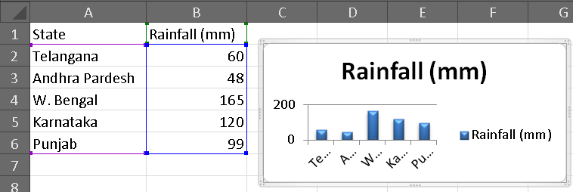
1.1 Simple/ Static Charts
Open a new workbook in Excel
Go to the Insert tab, click on the change chart type
Go to the design tab, click on the change chart type.

Slide 6
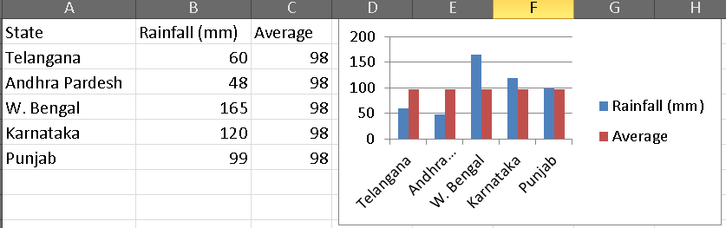
1.2 Combination chart
A combination chart is a chart that combines two or more chart types in a single chart.
Excel 2010 does not offer combo chart as one of the built-in chart type.
Select one group of chart > Change chart type

Slide 7
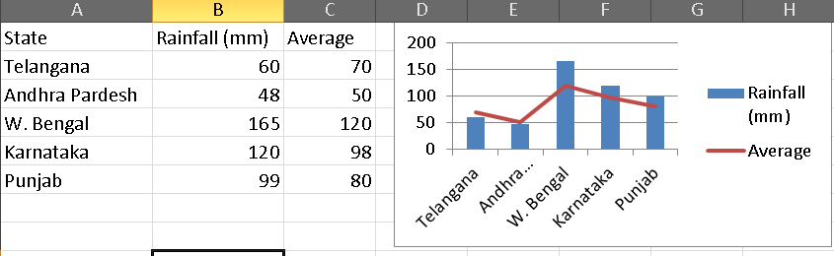
Change One of the Bars (to a Line)
Right click on one of the bars that represent the series to be changed (to a line) and select Change Series Chart Type from the menu
Select the type of chart required for this data series
Click OK

Slide 8
In Excel 2013 and above: changing your chart to a combo chart.
Click anywhere in the chart you want to change to a combo chart to show the CHART TOOLS.
Click DESIGN > Change Chart Type.
On the All Charts tab, choose Combo, and then pick the Clustered Column - Line on Secondary Axis chart.
Under Choose the chart type and axis for your data series , check the Secondary Axis box for each data series you want to plot on the secondary axis, and then change their chart type to Line.
Make sure that all other data series are shown as Clustered Column.
https://www.excel-easy.com/examples/combination-chart.html

Slide 9
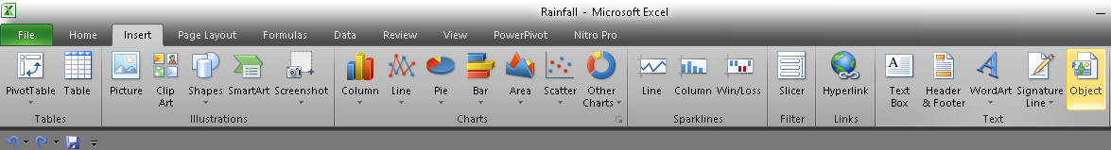
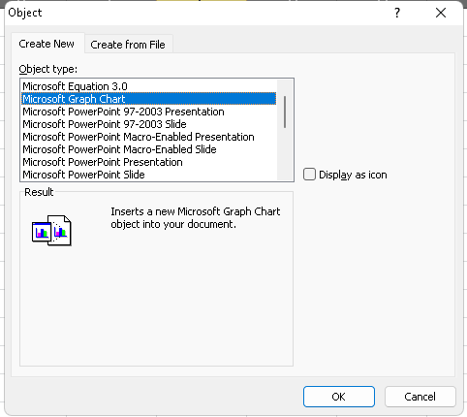
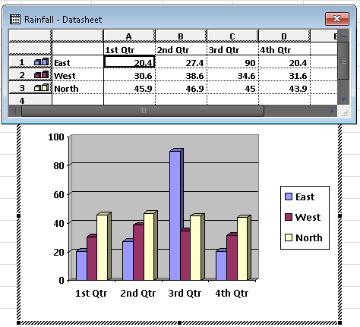
1.3 working with objects charts
https://www.youtube.com/watch?v=fe7hoDqFCgM

Slide 10
2. Dynamic charts and dynamic data source for charts print areas
Creating a Dynamic Chart Using a Table
Creating a Dynamic Chart Using a Formula
https://www.excel-university.com/how-to-make-an-excel-dynamic-chart/
https://www.youtube.com/watch?v=7le-m8YRP6M

Slide 11
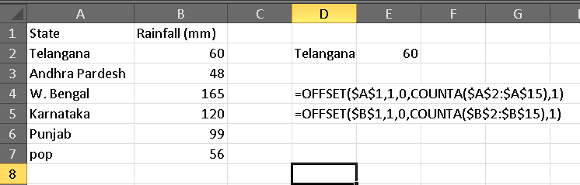
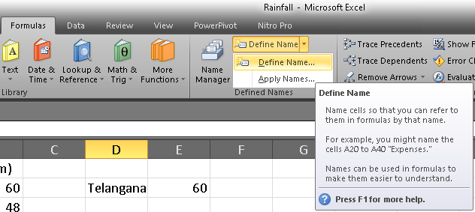
Using a Formula

Slide 12
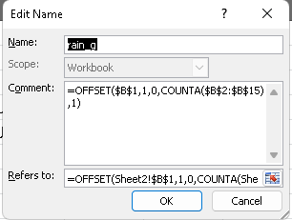
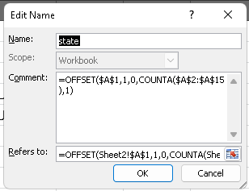
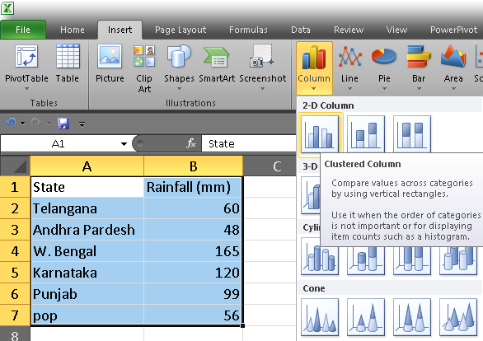

Slide 13
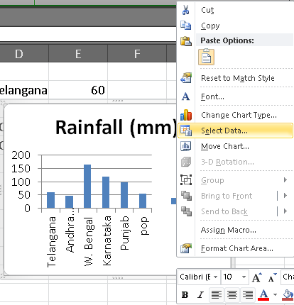
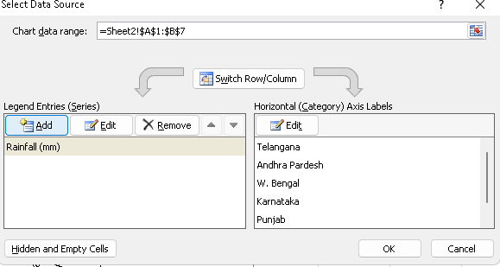
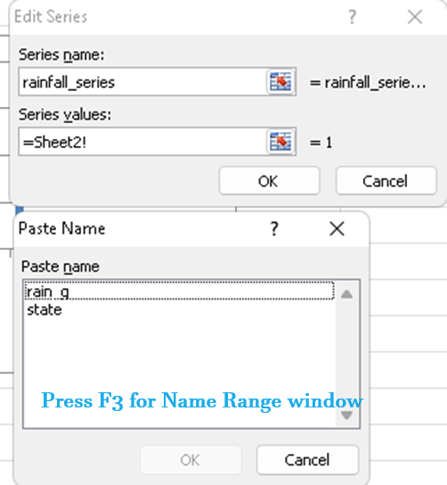

Slide 14
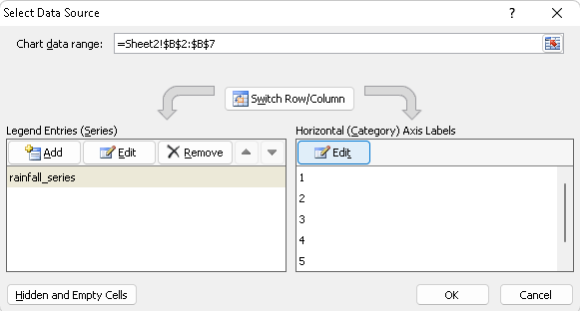
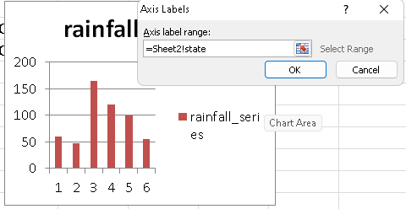

Slide 15
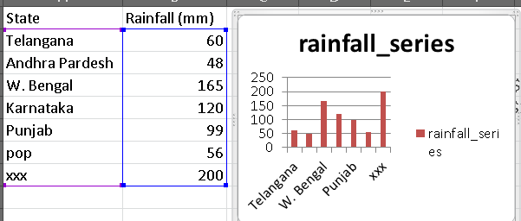

Slide 16
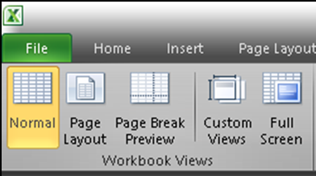
3. Views for a worksheet
Normal : At any time, you can switch back to Normal view for working
Page Break Preview: It gives you a nice overview of where pages break when you print the document.
Page Layout: to see where pages begin and end.

Slide 17
4. various printing techniques
Print one or several worksheets
Select the worksheets that you want to print.
Select File > Print, or press CTRL+P.
Select the Print button or adjust Settings before you select the Print button.

Slide 18
4.1 Print one or several workbooks
All workbook files that you want to print must be in the same folder.
Select File > Open.
Hold down CTRL click the name of each workbook to print, and then select Print.

Slide 19
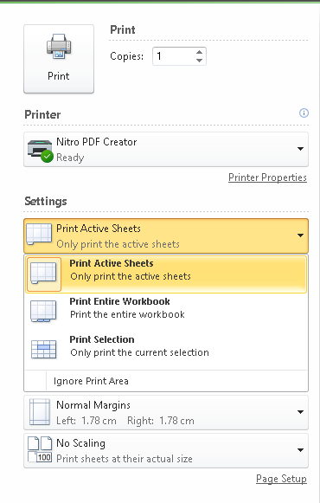

Slide 20
5. Data protection techniques
Complete Workbook Protection
Worksheet level protection
Protect selected range
Protect workbook Structure and window
https://www.nurturetechacademy.in/5-ways-protect-excel-data/

Slide 21
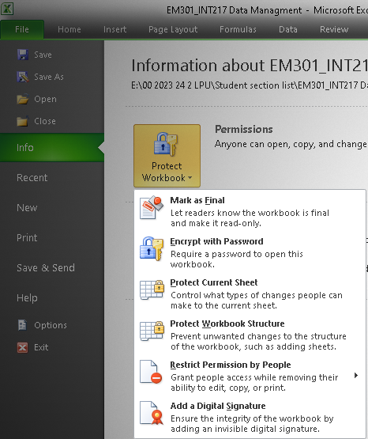
5.1 Complete Workbook Protection

Slide 22
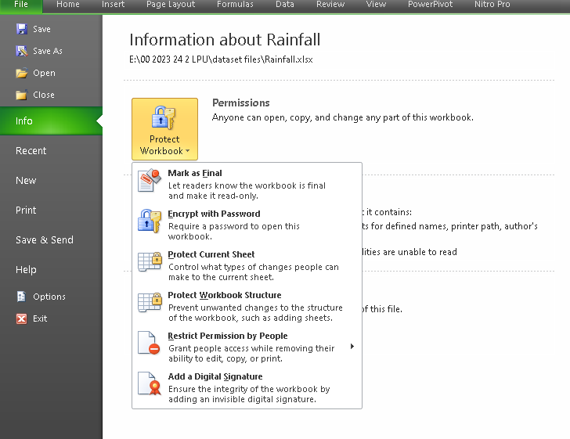
5.1 Worksheet protection

Slide 23
5.2 Protect specific range

Slide 24
5.3 Workbook protection and encryption.

